Slide 1
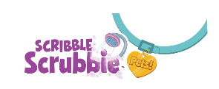
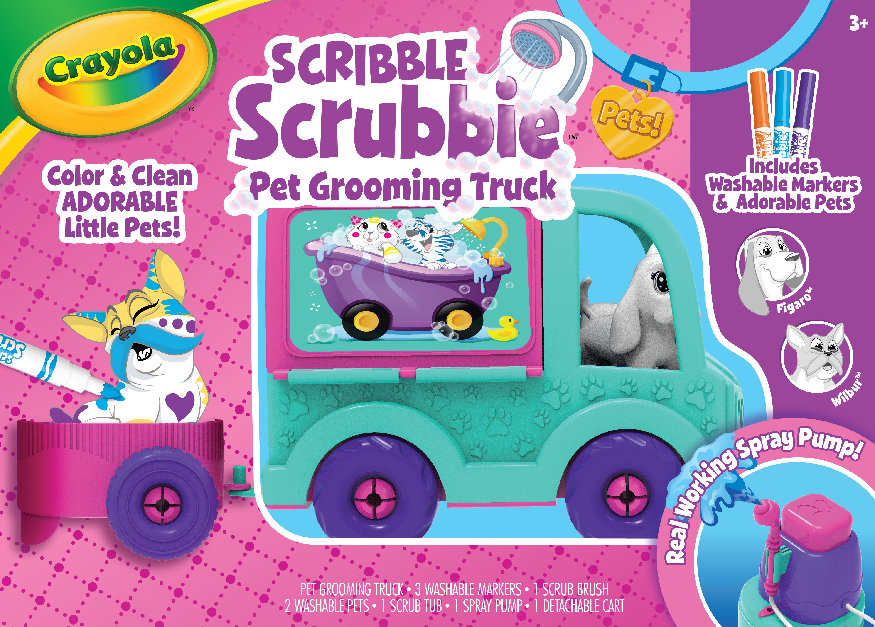
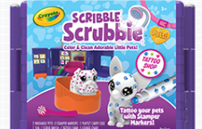
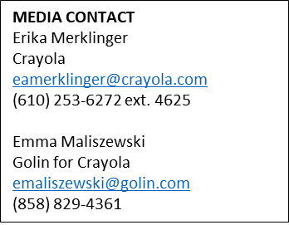
SCRIBBLE SCRUBBIE PETS
Crayola introduces two new ways to play with your Scribble Scrubbie Pets! These small and colorable pets are easy to color and clean, and kids will love their new life-like environments; a real working mobile grooming truck and a tattoo shop complete with a rotating chair.
Product Descriptions
Scribble Scrubbie Pets Grooming Truck: Features a real working spray pump that easily allows kids to wash their pet; just like they would in a real grooming truck. Pets Grooming Truck doubles as a storage solution that’s easy to pack up and store for later use
Includes 3 Ultra-Clean Washable Markers, 2 pets, scrub brush, 1 small scrub tub and spray pump
Scribble Scrubbie Pets Tattoo Shop: Features a new way for kids to color their adorable little pets - with Ultra-Clean Washable Stamper Markers. Kids can place their pet on the rotating tattoo chair and stamp away. When pets are ready for cleaning, place them in the included tub with water and scrub away. Shop folds to create a convenient storage solution for parents.
Includes 2 new pets: Winston the Bulldog and Lola the Chihuahua, 2 Ultra-Clean Washable Stamper Markers, scrub brush and small tub
Target Audience
Children aged 3 years and older
How to Buy
Grooming Truck: $19.99
Tattoo Shop: $14.99
Available at Crayola.com and retailers nationwide August 2020

Slide 2
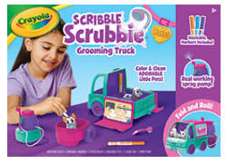
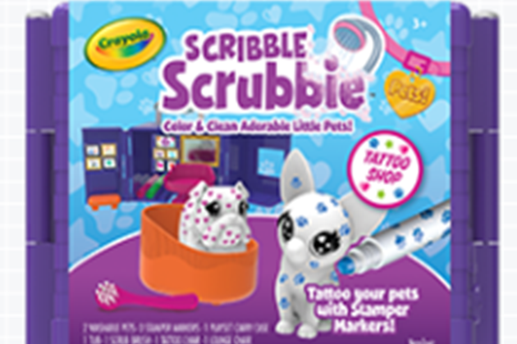
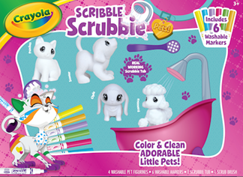
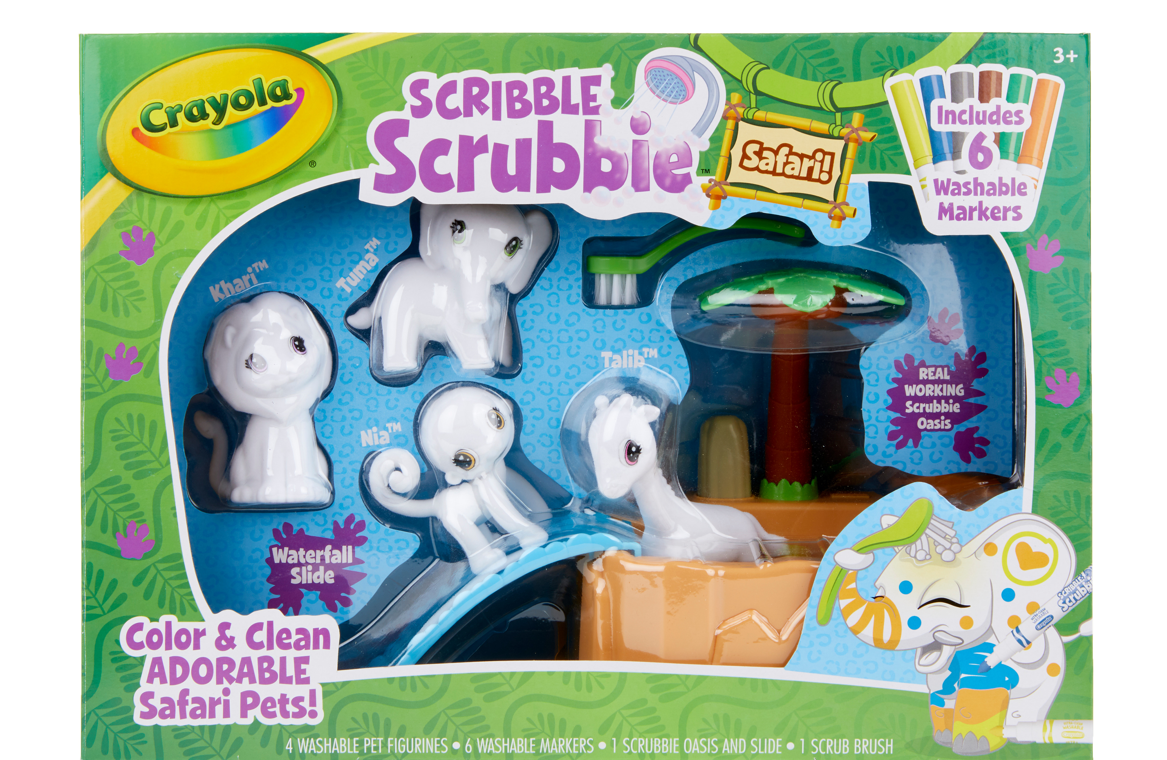
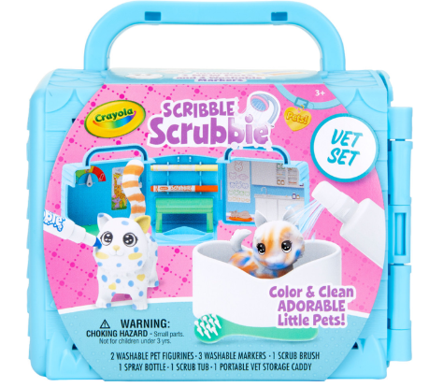
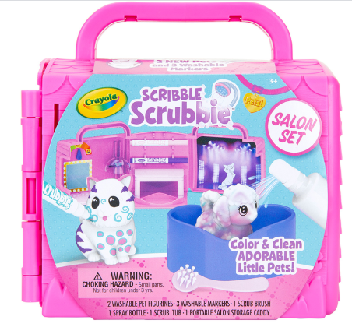
SCRIBBLE SCRUBBIE PETS
Scribble Scrubbie Pets
NEW- Grooming Truck
Price: $19.99
Available August 2020
Contents:
2 pets, 3 Ultra-Clean Washable markers, spray pump, scrub brush and tub
Scribble Scrubbie Pets
NEW- Tattoo Shop
Price: $14.99
Available August 2020
Content:
2 new pets, 2 Ultra-Clean Washable stampers, scrub brush, tub
Scribble Scrubbie Pets
Scrub Tub Playset
Price: $19.99
Available Now
Contents:
4 pets, 6 Ultra-Clean Washable markers, scrub brush and tub
Scribble Scrubbie Pets
Safari Set
Price: $19.99
Available Now
Contents:
4 safari pets, 6 Ultra-Clean Washable markers, 1 scrub brush and tub
Scribble Scrubbie Pets
Vet Set
Price: $14.99
Available Now
Contents:
2 pets, 3 Ultra-Clean Washable markers, 1 scrub brush and spray bottle
Scribble Scrubbie Pets
Salon Set
Price: $14.99
Available Now
Contents:
2 pets, 3 Ultra-Clean Washable markers, 1 scrub brush and spray bottle

